Slide 1
Diamond Price Prediction
By
Ayushi Bolia (E23010)
Barkha Tyagi (E23011)
Devanshi Hingrajiya (E23012)

Slide 2
Content

Slide 3
Statement of Purpose
This repository serves as a guide for developing a regression model that can predict the cost of a diamond depending on its various features

Slide 4
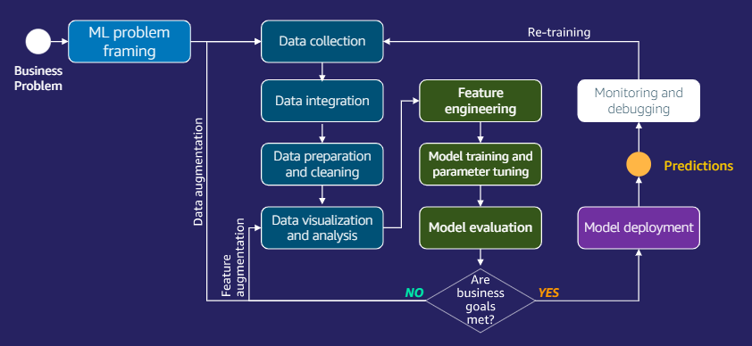

Slide 5
EDA
Cleaned the data

